Slide 1
WEEK 9
Moles and mass

Slide 2
The mass of 1 mole of a substance is called the molar mass, symbol M. The units of molar mass are grams per mole( g/mol or g mol⁻¹).
One mole of any substance has a mass equal to the relative atomic, molecular or formula mass of that substance expressed in grams.
Do try yourself Q’s from page: 240 (Q: a and d)

Slide 3
Converting between moles and mass
Relationship between the number of moles (n), mass(m) and the molar mass(M) of a substance is given by:
Number of moles= mass(g)
        molar mass(g/mol⁻¹)
        n = m/M

Slide 4
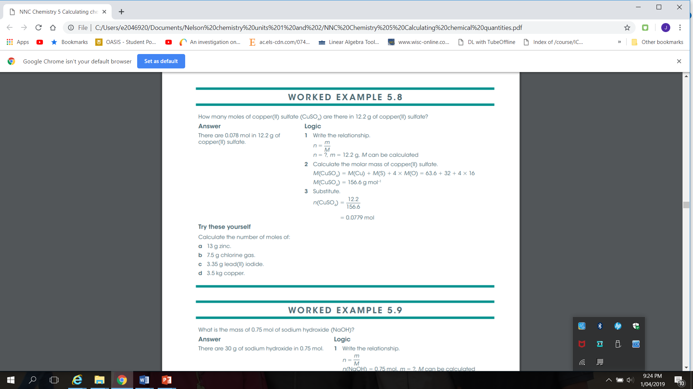

Slide 5
Complete questions (set 23) from page: 156 -Exploring Chemistry
Questions: 1( a ), 2 ( b ), 3 ( a ), 6 (b ), 7 ( b and c) and 8 ( c )

